Slide 1
Data Science Project

Slide 2
Overview:
In recent decades, air pollution has grown to be a major concern along with economic development and expansion. The World Health Organization claims that both short-term and long-term exposure to harmful air pollution is a key risk factor for human diseases like cancer, eye irritation, skin disorders, cardiovascular diseases, and respiratory diseases. Now accounting for one in ten fatalities worldwide, air pollution is the fourth-leading cause of preventable mortality. The major priority of the health and environmental agencies is to reduce air pollution. The secret to controlling air pollution is prompt air quality monitoring and precise forecasting of changes in air pollutants, such as lead, sulfur oxides, nitrogen oxides, CO, and particle pollution (PM2.5 and PM10). [1]
I used machine learning models in this project to forecast the level of concentration of particle 2.5 then evaluate the performance of these models and analyze the major factors.
In this project we are asked to use tree-based models such as Random-Forest tree, Gradient boosting tree and then Neural Network model to forecast PM2.5.
Then I discussed the performance of all the three models using MAE (Mean Absolute Error), RMSE (Root Mean Square Error) and then I plotted the ROC (Receiver Operating characteristic) curve for each model.
Lastly, I analyzed all the results and plotted the graphs that I used in this project

Slide 3
Random Forest Tree:
An ensemble classification method known as random forest (RF) has demonstrated supremacy and high accuracy. The scientific community has recently paid significant attention to RF to further improve its effectiveness with one shared purpose in mind. [3]
The linearity of the data is assumed in linear regression. While this presumption makes the model simple to understand, it frequently limits its ability to forecast. In general, random decision trees tend to predict more accurately than linear regression because they can quickly adjust to nonlinearities in the data. More precisely, medium to big datasets are highly suited for ensemble learning methods like random forests. The methods for logistic regression and linear regression will not operate when the number of independent variables is greater than the number of observations because there are too many estimated parameters. Because not all predictor variables are used at once, random forest works. Such algorithmic advancements are only helpful for social scientists to the extent that they have access to an algorithm's implementation. [4]

Slide 4
Gradient Boosting Tree:
A group of potent machine-learning methods known as gradient boosting machines has achieved notable success in a variety of real-world applications. They can be learned regarding various loss functions, for example, and are extremely adaptable to the specific needs of the application. The concept of gradient boosting approaches is introduced in this article with a significant emphasis on modeling aspects of machine learning. Descriptive examples and illustrations that span all the steps of the gradient boosting model design are used to supplement theoretical material. It is explained how to handle the complexity of the model. [2]
Neural Network Model:
As fresh data is presented, a machine (i.e., computer) decides for itself how to process the input data and anticipates outcomes. A machine learning algorithm called an artificial neural network is based on the idea of a human neuron. [7]

Slide 5
Decision Tree vs. LR
LR only allows linear solutions, whereas decision trees support non-linearity.
Decision trees and random forests may not perform as well when there are many characteristics and few data sets (and low noise). Decision trees will typically have superior average accuracy.
Decision trees outperform linear regression for independent variables that fall into a categorical category.
Compared to LR, decision trees handle collinearity better. [5]
Random Forest Tree vs. LR:
Key advantages of linear models over tree-based ones are:
they can extrapolate (e.g. if labels are between 1-5 in train set, tree-based model will never predict 10, but linear will)
could be used for anomaly detection because of extrapolation
interpretability (yes, tree-based models have feature importance, but it's only a proxy, `ights in linear model are better)
need less data to get good results
have strong online learning implementations (Vowpal Wabbit), which is crucial to work with giant datasets with a lot of features (e.g. texts) [6]

Slide 6
Evaluation:
Random Forest Tree:
Here I took random Forest Model first to see how good this model is for this airquality data. Here I took RandomForestClasssifier to calculate the accuracy. I found the accuracy of my model is 88%.
MAE:
The mean of the absolute errors, or MAE, is just what its name implies. The difference between the predicted value and the actual value, expressed as an absolute number, is the absolute error. The MAE reveals the average size of the forecast error that we can anticipate.
I got MAE 0.24
MSE:
I got MSE 0.48 and root mean squared error 0.69

Slide 7
ROC and AUC( Area Under The Curve ):
An ROC curve (receiver operating characteristic curve) is a graph showing the performance of a classification model at all classification thresholds. This curve plots two parameters:
True Positive Rate
False Positive Rate
True Positive Rate (TPR) is a synonym for recall and is therefore defined as follows:
TPR= TP/(TP+FN)
False Positive Rate (FPR) is defined as follows:
FPR= FP/(TN+FP)
An ROC curve plots TPR vs. FPR at different classification thresholds. Lowering the classification threshold classifies more items as positive, thus increasing both False Positives and True Positives

Slide 8
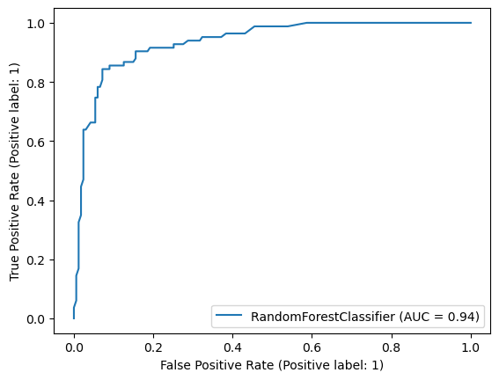

Slide 9
Gradient Boosting Tree:
Here I took Gradient Boosting Tree to see how good this model is for this airquality data. Here I took Gradient Boosting to calculate the accuracy. I found the accuracy of my model is 86.8%.
MAE:
I got MAE 0.2640
MSE:
I got MSE 0.528 and root mean squared error 0.72663

Slide 10
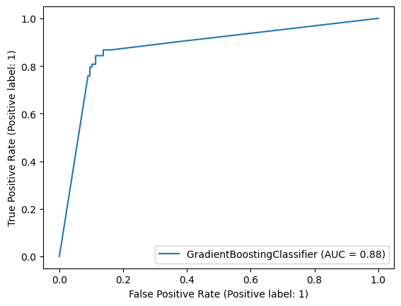
ROC and AUC( Area Under The Curve ):
AUC for this model came 0.88

Slide 11
Neural Network:
Here I took Neural Network to see how good this model is for this airquality data. Here I took Neural Network to calculate the accuracy. I found the accuracy of my model is 82.8%.
MAE:
I got MAE 0.3840
MSE:
I got MSE 0.768 and root mean squared error 0.876

Slide 12
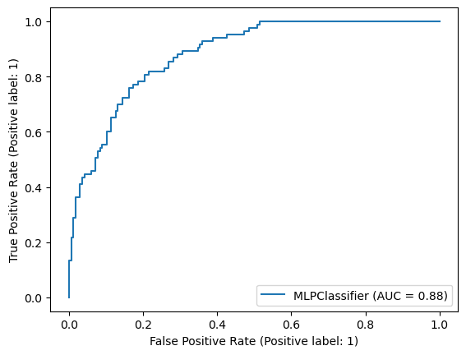
ROC and AUC( Area Under The Curve ):
AUC for this model came 0.88

Slide 13
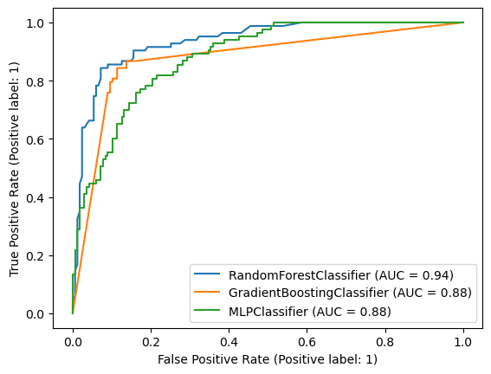
Comparison of All three models:

Slide 14
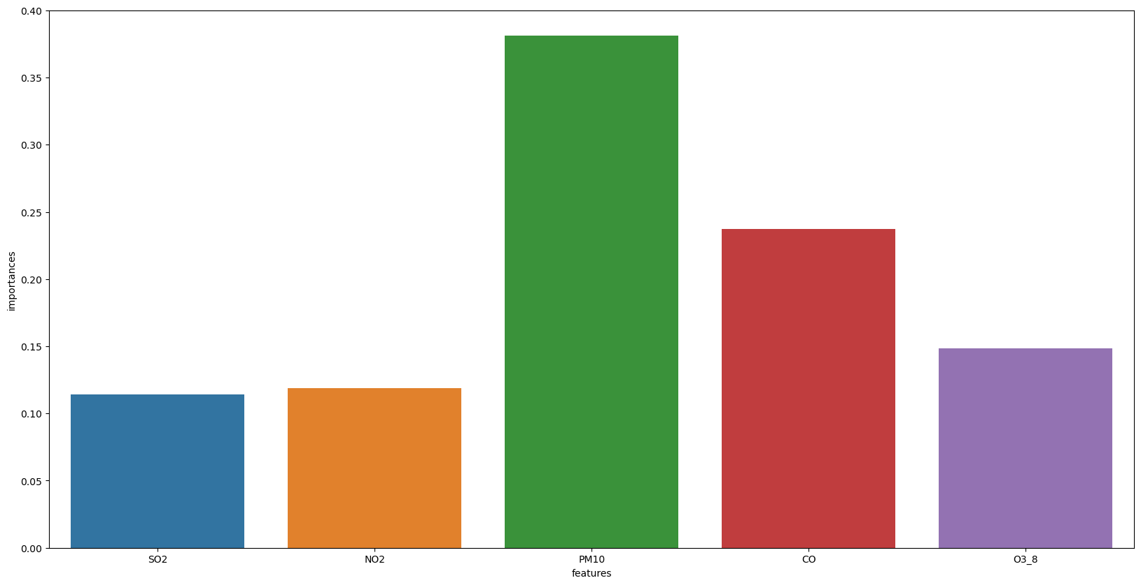
Interpretability:
Permutation feature importance for Random Forest Tree

Slide 15
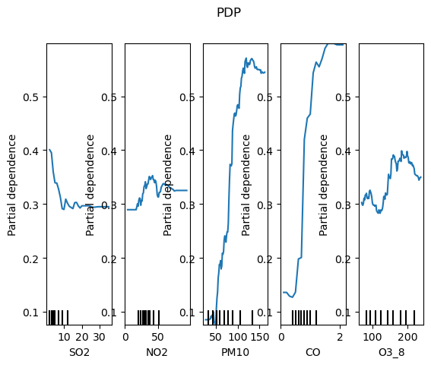
PDP for Random Forest

Slide 16
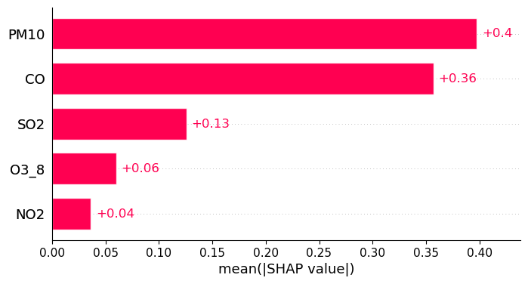
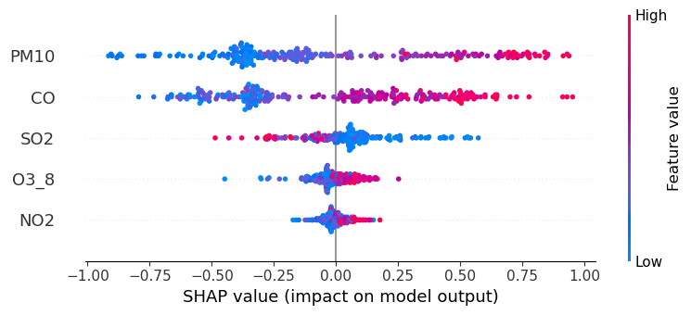
SHAP for RANDOM FOREST

Slide 17
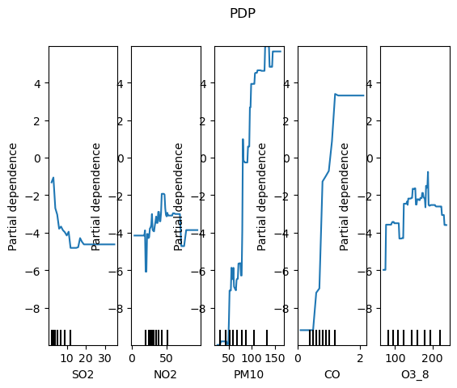
PDP for Gradient Boosting:

Slide 18
SHAP for Gradient Boosting:

Slide 19
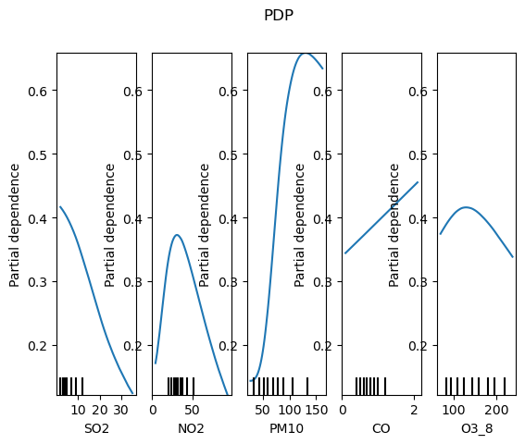
PDP for Neural Network

Slide 20
Conclusion:
To conclude, after looking at all the measures to check a model’s perfectness we can say that Random Forest gives us the best solution for this particular dataset. It predicted PM25 better than rest of the other models like Gradient Boosting Trees and Neural Network. After Random Forest Tree Gradient Boosting Tree performed well and Neural Network model’s accuracy was after this.
If we talk about the ROC curve we can say Random Forest Tree was better than rest of the other two models.
While interpreting the model, which feature created most impact we saw that PM10 was the most important factor that contributed most to predict PM25. We used different metrics like SHAP, Permutation Feature Importance and PDP to show the most influencing feature.
So, we can say that Random Forest Tree is the best model for this dataset to predict PM25 levels and PM10 is the most significant feature among all the features.

Slide 21
References:
1. World Health Organization. (n.d.). Health impacts. World Health Organization. Retrieved April 19, 2023, from https://www.who.int/teams/environment-climate-change-and-health/air-quality-and-health/health-impacts
2. Natekin, A. and Knoll, A. (2013) Gradient Boosting Machines, a tutorial, Frontiers. Frontiers. Available at: https://www.frontiersin.org/articles/10.3389/fnbot.2013.00021/full (Accessed: April 19, 2023).
3. Fawagreh, K., Gaber, M.M. and Elyan, E. (2014) “Random forests: From early developments to recent advancements,” Systems Science & Control Engineering, 2(1), pp. 602–609. Available at: https://doi.org/10.1080/21642583.2014.956265.
4. Fawagreh, K., Gaber, M.M. and Elyan, E. (2014) “Random forests: From early developments to recent advancements,” Systems Science & Control Engineering, 2(1), pp. 602–609. Available at: https://doi.org/10.1080/21642583.2014.956265.
5. Fawagreh, K., Gaber, M.M. and Elyan, E. (2014) “Random forests: From early developments to recent advancements,” Systems Science & Control Engineering, 2(1), pp. 602–609. Available at: https://doi.org/10.1080/21642583.2014.956265.
6. Telsemeyer, S. (2020) Combining tree based models with a linear baseline model to improve extrapolation, Medium. Towards Data Science. Available at: https://towardsdatascience.com/combining-tree-based-models-with-a-linear-baseline-model-to-improve-extrapolation-c100bd448628 (Accessed: April 19, 2023).
7. Han, S.-H. et al. (2018) “Artificial Neural Network: Understanding the basic concepts without mathematics,” Dementia and Neurocognitive Disorders, 17(3), p. 83. Available at: https://doi.org/10.12779/dnd.2018.17.3.83.

Slide 22

Questions?

